Slide 1

YOUR PROPERTY CONTACT
Barbara de Guzman
Prestige Property Group
Accredited Seller of Moldex Realty
Digital Property Specialist
AI Operations Manager
MetroGate Trece Martires presentation

Slide 2
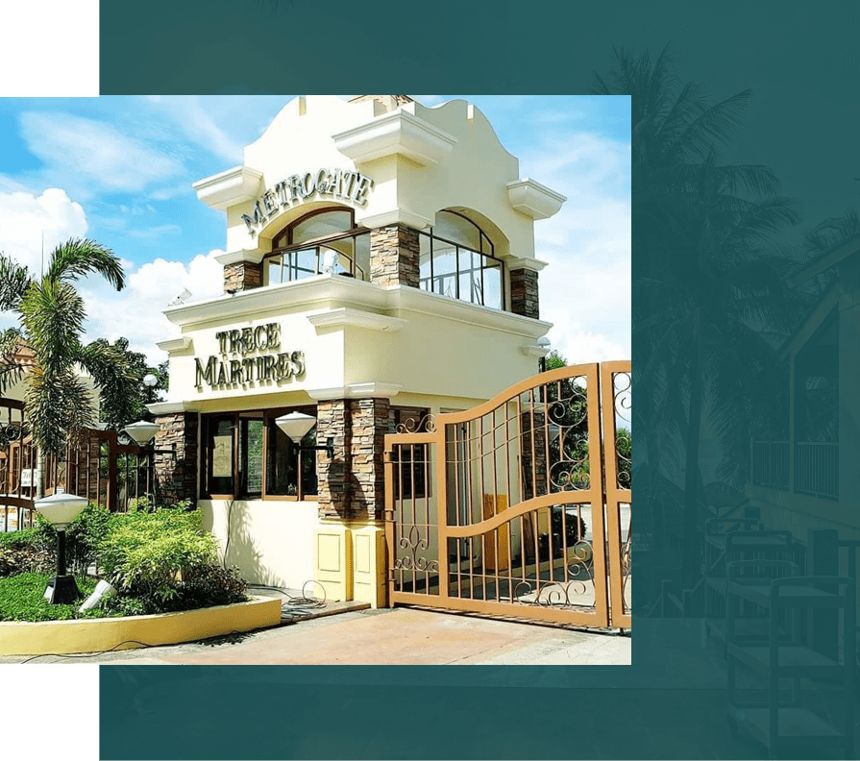
MOLDEX REALTY · PROJECT PRESENTATION
MetroGate Trece Martires
Brgy. De Ocampo and Gregorio Aliang,
Trece Martires City, Cavite
Established residential community with house-and-lot and lot-only options
Barbara de Guzman
Digital Property Specialist
Buyer presentation · October 2026
Notes:
Official project source and image: https://www.moldexrealty.ph/metrogate-trece-martires/

Slide 3
Moldex history
From manufacturing roots to residential development
Mid-1960s
Manufacturing roots
The Moldex legacy began with plastic products, including PVC pipes and fittings.
1987
Moldex Realty established
The Uy family expanded into real estate development and formed Moldex Realty.
1988
First MetroGate development
MetroGate introduced a new class of master-planned residential subdivision.
Today
More than 30 projects
Moldex reports 35+ years of development across subdivisions and condominiums in Luzon.
MetroGate Trece Martires
02
Notes:
Sources: https://www.moldexrealty.ph/about-us/; Moldex Realty company history and project count. Dates and claims should be read as company-published information.

Slide 4
Project overview
A concise view of the community and its positioning
Development scale
58.40 ha
Product types
House & Lot | Lot only
Official location
Brgy. De Ocampo and Gregorio Aliang, Trece Martires City, Cavite
MetroGate Trece Martires
03
Notes:
Source: MetroGate Trece Martires fact sheet in the user-provided Google Drive. The fact sheet lists 58.40 hectares, house-and-lot and lot-only products, and Brgy. M. Gregorio Aliang. Current Drive computations list Brgy. De Ocampo and Gregorio Aliang, so this presentation includes both locations.

Slide 5
Location and access
Project address and the clearest buyer-facing access points
Brgy. De Ocampo and Gregorio Aliang,
Trece Martires City, Cavite
Trece–Tanza Road
The community sits along the main Trece Martires and Tanza corridor.
Governor’s Drive
Travel west to Trece town proper, then continue to Trece–Tanza Road.
CAVITEX and SLEX access
Approach through Tanza from CAVITEX or through Carmona and Governor’s Drive from SLEX.
MetroGate Trece Martires
04
Notes:
Source: MetroGate Trece Martires fact sheet in the user-provided Google Drive. Access descriptions are directional guidance and do not promise travel times.

Slide 6
Why this location works
A practical fit for different buyer priorities
Established community
Flexible home choice
Essential infrastructure
Launched in 1996, with land development completed in September 2000 according to the project fact sheet.
The current Drive guide lists 17 models, ranging from 63 sqm to 187 sqm on lots starting at 120 sqm.
Security, lighting, drainage, water supply, concrete roads, and perimeter controls are listed features.
Use the next conversation to match the buyer’s preferred lot, house size, monthly budget, and timing.
MetroGate Trece Martires
05
Notes:
Sources: MetroGate Trece Martires fact sheet and MGTM house TCP guide in the user-provided Google Drive.

Slide 7
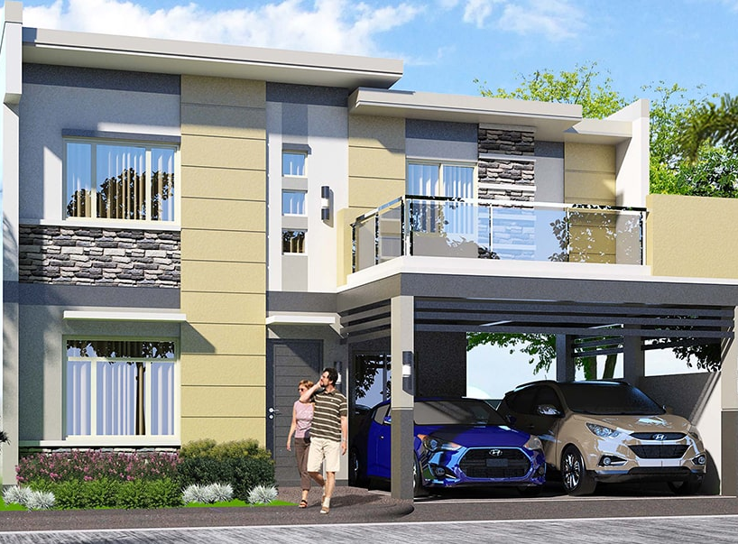
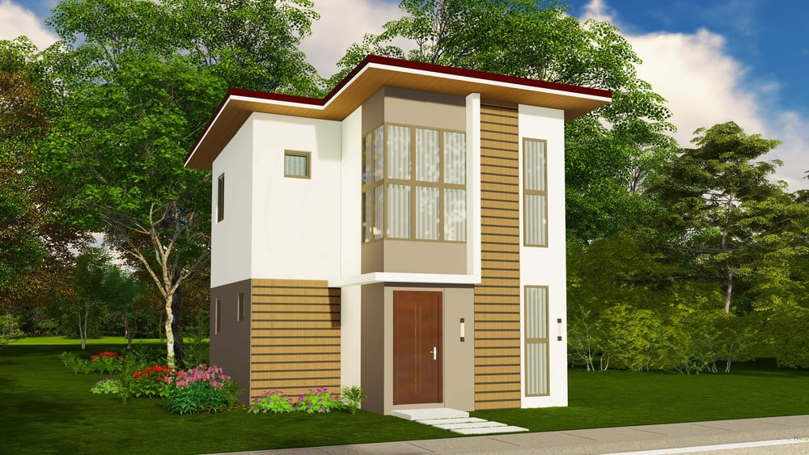
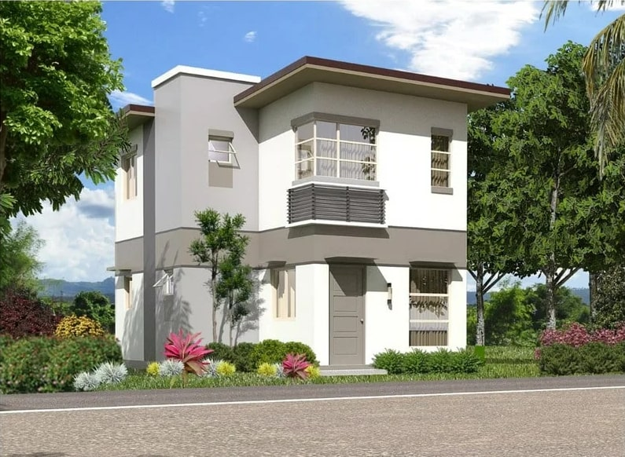
Amenities and community features
What residents can expect inside the development
Clubhouse
Children’s playground
Swimming pool
Pavilion
Fitness center
Entrance gate with guardhouse
Basketball court
24/7 security
Tennis court
Confirm current operating status, rules, and availability of each facility during the site visit.
MetroGate Trece Martires
06
Notes:
Source: MetroGate Trece Martires fact sheet in the user-provided Google Drive. Confirm current facility schedules, operating rules, and availability during the site visit.

Slide 8
House model choices
17 current models across a range of household needs
House model | Floor area (sqm) | Beds | Baths | Min. lot (sqm)
Aurora | 155 | 3 | 3 | 120
Brie | 76 | 3 | 2 | 120
Chloe | 120 | 3 | 3 | 120
Elise | 64 | 3 | 2 | 120
Eloise | 80 | 2 | 1 | 120
Gracie | 172 | 3 | 3 | 120
Helena | 70 | 2 | 2 | 120
Ivanah | 166 | 3 | 3 | 120
Jasmine 60 | 63 | 2 | 2 | 120
Jasmine 90 | 126 | 2 | 2 | 120
Jasmine 100 | 127 | 3 | 4 | 120
Julien | 171 | 3 | 3 | 120
Kathryn 60 | 63 | 2 | 1 | 120
Kathryn 100 | 139 | 2 | 3 | 120
Kathryn 118 | 160 | 3 | 3 | 120
Kathryn 128 | 187 | 3 | 3 | 120
Shannon | 157 | 3 | 3 | 120
Specifications come from the current Drive guide. Confirm inventory, inclusions, and approved pricing before presenting.
MetroGate Trece Martires
07
Notes:
Source: MGTM HOUSE TCP guide in the user-provided Google Drive, modified May 2026. The table preserves the guide’s published model names, floor areas, bedroom and toilet-and-bath counts, and minimum lot areas.

Slide 9
Model home spotlight
Three options to start the buyer conversation
Eloise
Brie
Helena
80 sqm · 2 bedrooms · 1 bathroom
76 sqm · 3 bedrooms · 2 bathrooms
70 sqm · 2 bedrooms · 2 bathrooms
Images are architectural perspectives. Ask for the latest finish schedule, inclusions, and available inventory.
MetroGate Trece Martires
08
Notes:
Model images and specifications are from Moldex Realty's official project pages. Perspectives are illustrative and may differ from delivered units.

Slide 10
Lot-only sample computation
120 sqm regular inner lot, calculated without promotional discounts
In-house term | Published rate | Monthly amortization | Estimated balance
5 years | 10% | ₱39,203.35 | ₱1,845,120
7 years | 13% | ₱33,566.36 | ₱1,845,120
10 years | 15% | ₱29,768.24 | ₱1,845,120
Sample property
120 sqm · Regular Inner
₱16,000 / sqm ex-VAT
Estimated package price
₱2,275,200
Includes 12% VAT and estimated registration fee
20% DP: ₱430,080. Less ₱20,000 reservation, net DP is ₱410,080 or ₱34,173.33/month for 12 months.
Illustrative no-discount estimate based on the Drive rate sheet and sample formula. Confirm the exact block and lot, VAT, fees, availability, and approved terms before presenting or booking.
MetroGate Trece Martires
09
Notes:
Sources: .LOT PRICE guide and 120 sqm regular-inner lot-only computation in the user-provided Google Drive. This slide removes the 7% promotional discount and recalculates from ₱16,000 per sqm: list price ₱1,920,000; 12% VAT ₱230,400; contract price ₱2,150,400; estimated 6.5% registration fee on list price ₱124,800; package price ₱2,275,200. The amortizations use the same in-house rates and standard monthly payment formula shown in the Drive sample. This remains illustrative and requires an official quotation.

Slide 11
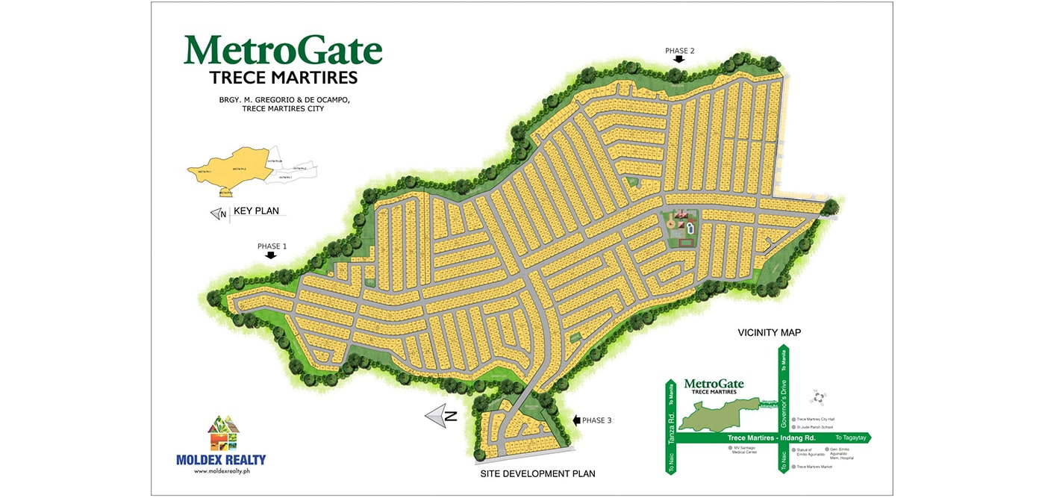
Site plan and selection guide
Move from project interest to the right block and lot
Review together
1. Preferred lot size
2. Inner, corner, main-road, clubhouse, or perimeter location
3. House model fit and setbacks
4. Monthly DP comfort
5. Inventory and official computation
6. Site visit and reservation process
MetroGate Trece Martires
10
Notes:
Official site development plan from Moldex Realty. Site plans are for orientation; rely on the latest official inventory and approved subdivision documents for a transaction.

Slide 12
Next steps
Let’s narrow the best MetroGate Trece Martires option for you.
01
Set your target
Preferred lot size, house model, budget, and move-in timeline.
02
Check live inventory
Confirm the exact block, lot, availability, and current approved price.
03
Visit and decide
Schedule a site tour, review the official computation, and reserve when ready.
Prepared from official Moldex Realty project pages and current internal reference rates. All transaction details remain subject to official verification.
Notes:
Close with the buyer's preferred lot size, target monthly budget, and site-visit availability. Confirm all inventory and pricing through official channels.

