Slide 1

YOUR PROPERTY CONTACT
Barbara de Guzman
Aspire Property Group
Accredited Seller of Moldex Realty
AI Operations Manager
MetroGate Silang Estates presentation
Notes:
Presenter details supplied by Barbara de Guzman. Existing Barbara profile portrait used from the Hunter Engine project assets.

Slide 2
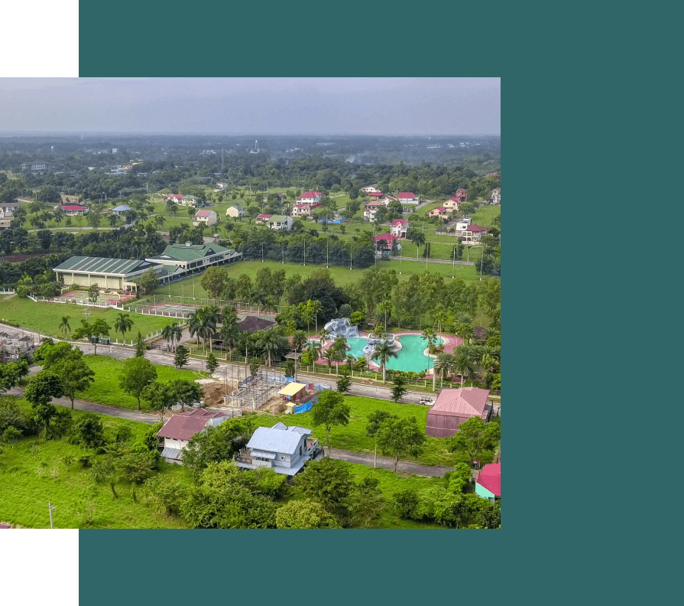
MOLDEX REALTY · PROJECT PRESENTATION
MetroGate Silang Estates
Aguinaldo Highway, Brgy. Biga, Silang, Cavite
A large-scale estate setting with education, leisure, and daily-life amenities
Buyer presentation · October 2026
Notes:
Official project source and image: https://www.moldexrealty.ph/metrogate-silang-estates/

Slide 3
Moldex history
From manufacturing roots to residential development
Mid-1960s
Manufacturing roots
The Moldex legacy began with plastic products, including PVC pipes and fittings.
1987
Moldex Realty established
The Uy family expanded into real estate development and formed Moldex Realty.
1988
First MetroGate development
MetroGate introduced a new class of master-planned residential subdivision.
Today
More than 30 projects
Moldex reports 35+ years of development across subdivisions and condominiums in Luzon.
MetroGate Silang Estates
03
Notes:
Sources: https://www.moldexrealty.ph/about-us/; Moldex Realty company history and project count. Dates and claims should be read as company-published information.

Slide 4
Project overview
A concise view of the community and its positioning
Development scale
Approx. 230–250 ha
Community anchor
Home to FEU Cavite
Official location
Aguinaldo Highway, Brgy. Biga, Silang, Cavite
MetroGate Silang Estates
04
Notes:
Source: official project page and Moldex Realty contact page. The Silang page uses both 230 hectares and 250 hectares; this presentation states approximately 230–250 hectares to preserve the source inconsistency.

Slide 5
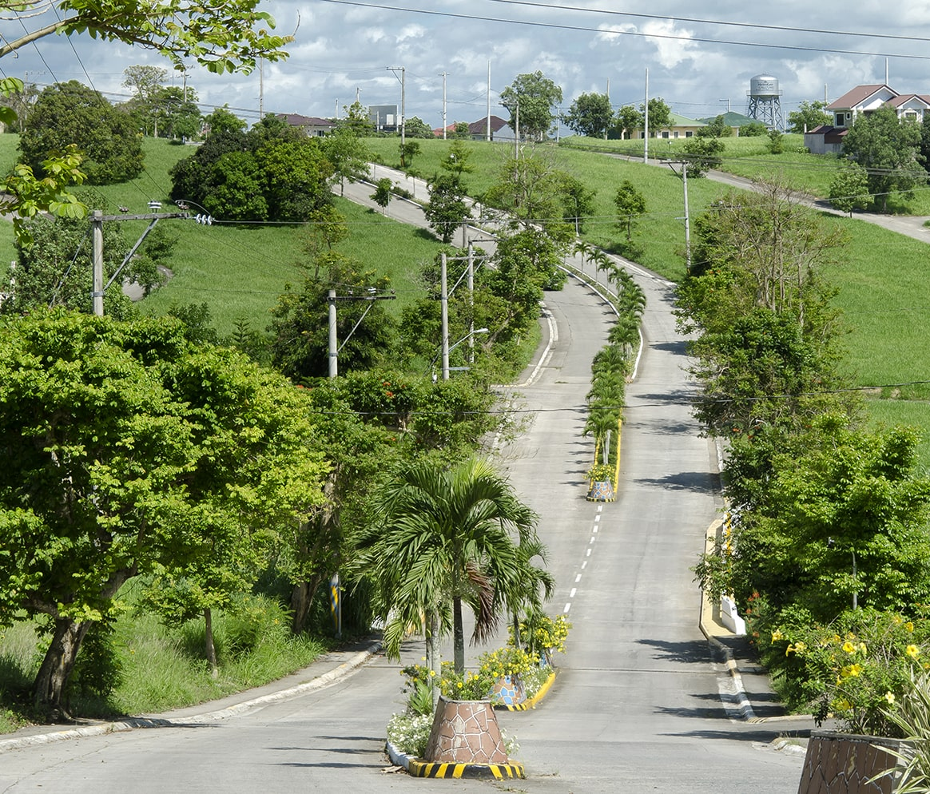
Location and access
Project address and the clearest buyer-facing access points
Aguinaldo Highway, Brgy. Biga, Silang, Cavite
Aguinaldo Highway frontage
Direct address on one of Cavite’s primary corridors.
Silang–Tagaytay growth belt
Positioned between established Cavite communities and Tagaytay destinations.
Education anchor
FEU Cavite is located within the master-planned estate.
MetroGate Silang Estates
05
Notes:
Source: official project page and https://www.moldexrealty.ph/contact-us/. Access descriptions are directional context, not travel-time commitments.

Slide 6
Why this location works
A practical fit for different buyer priorities
End-use living
Family planning
Long-horizon ownership
A spacious estate setting with daily-life, recreation, worship, education, and retail components.
Multiple house sizes allow buyers to match bedroom needs, lot size, and future space requirements.
Aguinaldo Highway frontage and a mature estate program support a long-term ownership story.
Use the next conversation to match the buyer’s preferred lot, house size, monthly budget, and timing.
MetroGate Silang Estates
06
Notes:
Buyer-fit statements are presentation framing based on the official project features. They are not investment-return projections.

Slide 7
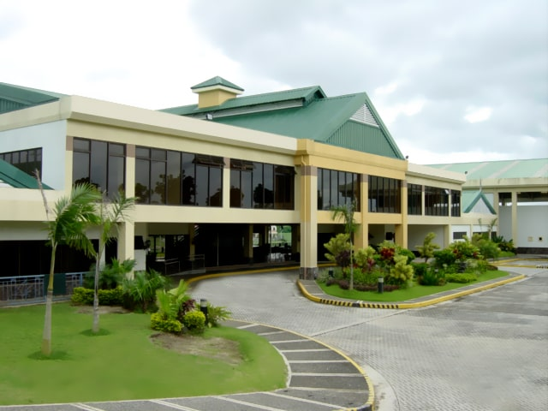
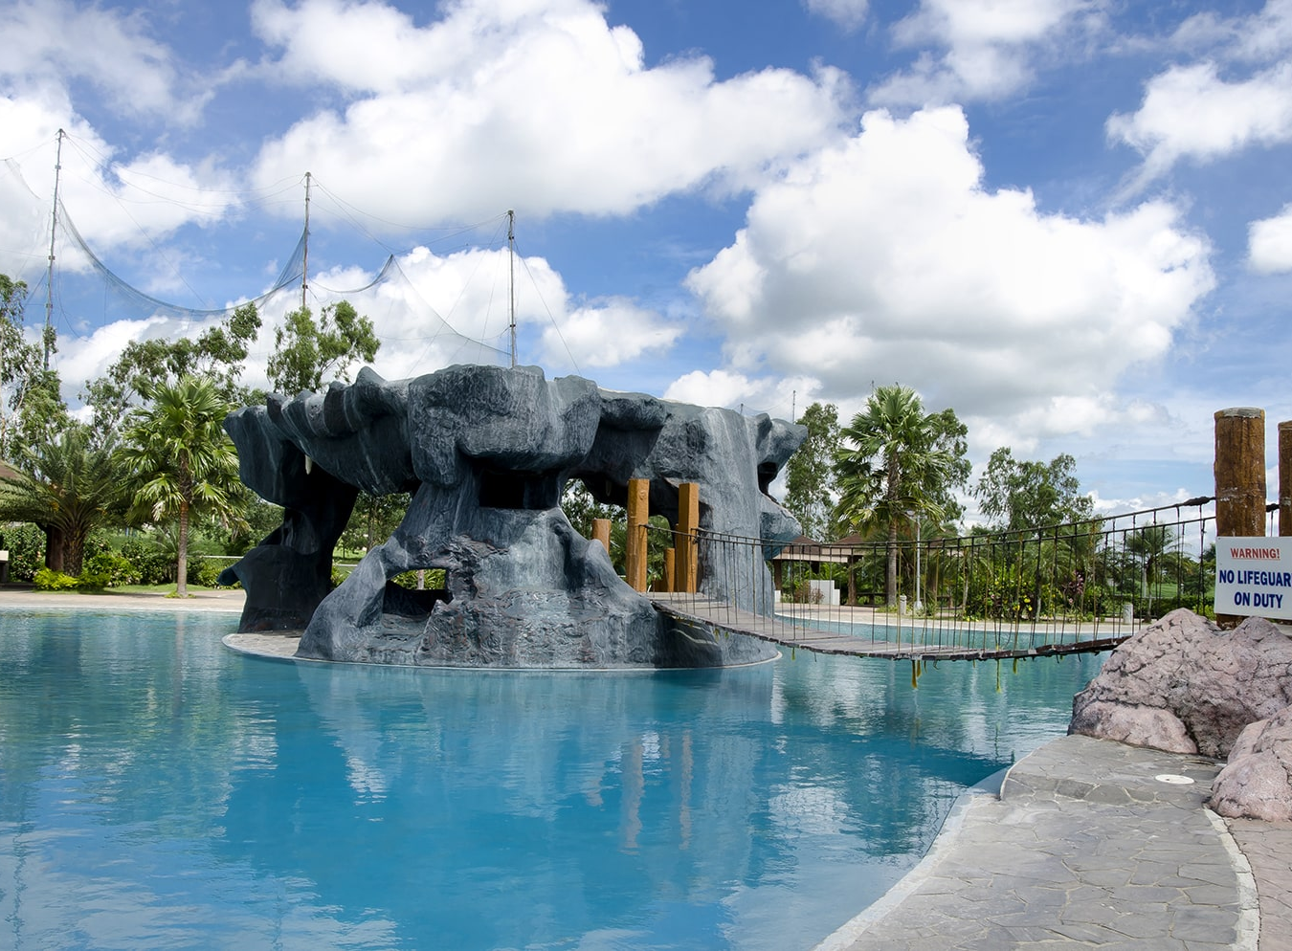

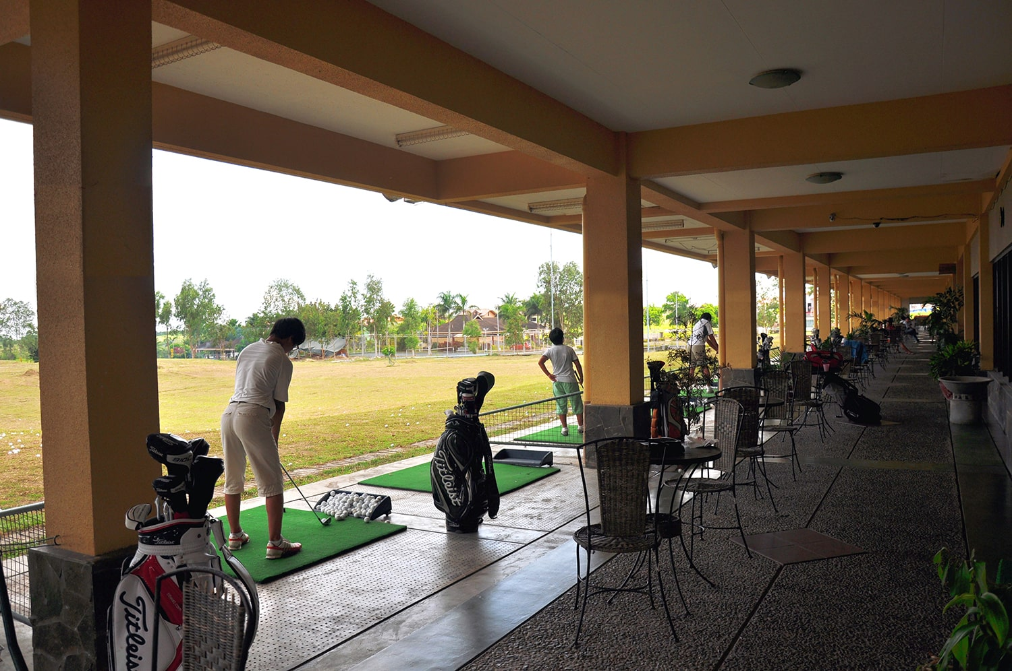
Amenities and community features
What residents can expect inside the development
Grand clubhouse
Commercial and retail center
Jungle pool
Tennis and basketball courts
Golf driving range
Fitness and function rooms
Japanese garden
Guarded gates and 24/7 security
Amphitheater
Two entry and exit points
Confirm current operating status, rules, and availability of each facility during the site visit.
MetroGate Silang Estates
07
Notes:
Amenities and features transcribed from the official project page: https://www.moldexrealty.ph/metrogate-silang-estates/

Slide 8
House model choices
10 published models across a range of household needs
House model | Floor area (sqm) | Beds | Baths | Min. lot (sqm)
Kathryn 128 | 187 | 3 | 4 | 120
Julien | 171 | 3 | 3 | 120
Ivanah w/ Firewall | 154 | 3 | 3 | 120
Kathryn 118 | 160 | 3 | 4 | 120
Jasmine 108 | 159 | 3 | 4 | 119
Shannon | 154 | 3 | 3 | 120
Kathryn 100 | 139 | 2 | 3 | 120
Jasmine 100 | 127 | 3 | 3 | 120
Chloe | 120 | 3 | 2 | 120
Aurora | — | 2 | 3 | 150
Published specifications may change. Aurora floor area is not displayed in the current project-page model list.
MetroGate Silang Estates
08
Notes:
Model list and published specifications: official MetroGate Silang Estates project page. Dashes indicate a value not shown in the page's summary list.

Slide 9
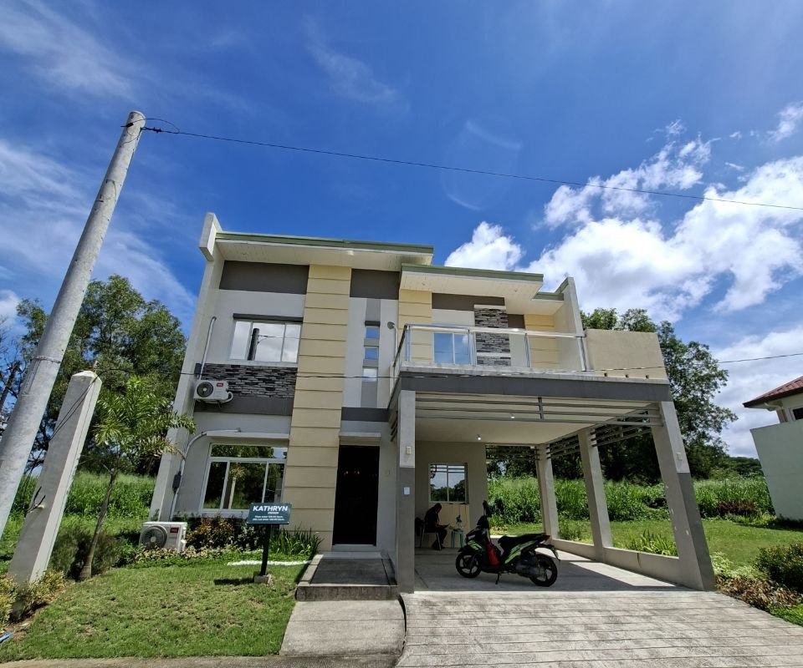
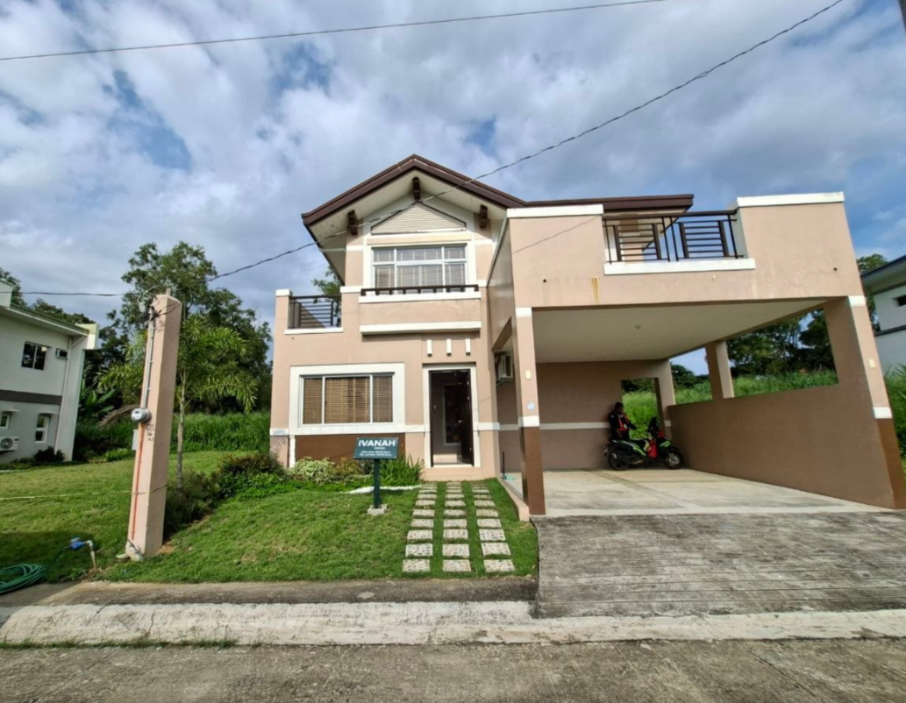
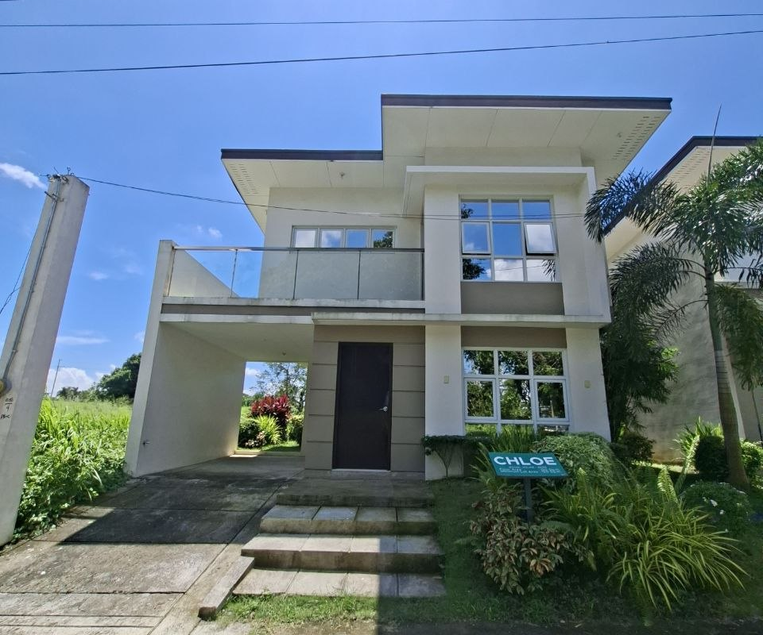
Model home spotlight
Three options to start the buyer conversation
Kathryn Dressed
Ivanah Dressed
Chloe Bare
Actual model home · 128 sqm floor area · 120 sqm minimum lot
Actual model home · 166 sqm floor area · 120 sqm minimum lot
Actual model home · 120 sqm floor area · 120 sqm minimum lot
All three images show actual model homes. Confirm current finishes, inclusions, and available inventory.
MetroGate Silang Estates
09
Notes:
Kathryn, Ivanah, and Chloe photographs were supplied by the user and show actual model homes. The photographed signs state Kathryn Dressed floor area 128 sqm, Ivanah Dressed floor area 166 sqm, and Chloe Bare floor area 120 sqm. Each sign states a 120 sqm minimum lot. The separate computation in the next slide is for Ivanah with Firewall at 154 sqm, a different published variant.

Slide 10
Ivanah house and lot
Sample computation for Phase 9, 120 sqm regular inner lot, Ivanah with firewall
In-house term | Published rate | Monthly amortization
5 years | 10% | ₱158,123.91
7 years | 13% | ₱135,388.07
10 years | 15% | ₱120,068.31
Package basis
Lot price: ₱2,664,000
House price: ₱5,642,000
Net list price: ₱8,306,000
12% VAT: ₱996,720
Contract price: ₱9,302,720
Cash required during DP
20% down payment: ₱1,860,544
Less reservation: ₱40,000
Move-in fee: ₱124,590
Registration fee: ₱539,890
Net down payment: ₱2,485,024
Net DP options
12 months: ₱207,085.33 per month
24 months, subject to approval: ₱103,542.67 per month
Attached sample computation. Total package price is ₱9,842,610, including the registration fee. Prices, rates, discounts, availability, and approval remain subject to Moldex Realty's current official computation.
MetroGate Silang Estates
10
Notes:
Source: user-provided MetroGate Silang Estates sample computation for Ivanah with Firewall, Phase 9, 120 sqm regular inner lot. Arithmetic check: ₱2,664,000 lot + ₱5,642,000 house = ₱8,306,000 net list; 12% VAT = ₱996,720; TCP = ₱9,302,720; 6.5% registration fee on net list = ₱539,890; total package = ₱9,842,610. Net DP = ₱1,860,544 less ₱40,000 reservation plus ₱124,590 move-in fee plus ₱539,890 registration fee = ₱2,485,024. Source states validity of seven calendar days and that final terms require management approval.

Slide 11
Lot-only computation
Phase 9, 120 sqm regular inner lot
In-house term | Published rate | Monthly amortization
5 years | 10% | ₱54,836.03
7 years | 13% | ₱46,951.43
10 years | 15% | ₱41,638.67
Package basis
Lot price: ₱2,664,000
12% VAT: ₱319,680
Contract price: ₱2,983,680
Registration fee: ₱193,939.20
Total package price: ₱3,177,619.20
Down payment
20% down payment: ₱596,736
Less reservation: ₱20,000
Net down payment: ₱576,736
12 months: ₱48,061.33
24 months, subject to approval: ₱24,030.67
Financed balance: ₱2,386,944
Registration fee: ₱193,939.20
Total balance with registration: ₱2,580,883.20
Attached sample computation. Prices, rates, availability, and approval remain subject to Moldex Realty's current official computation.
MetroGate Silang Estates
11
Notes:
Source: user-provided MetroGate Silang Estates lot-only computation for Phase 9, 120 sqm regular inner lot. Arithmetic check: ₱2,664,000 lot price plus 12% VAT of ₱319,680 gives a contract price of ₱2,983,680. Registration fee is ₱193,939.20 and total package price is ₱3,177,619.20. Net down payment is ₱596,736 less ₱20,000 reservation, or ₱576,736. The source states validity of seven calendar days and that final terms require management approval.

Slide 12
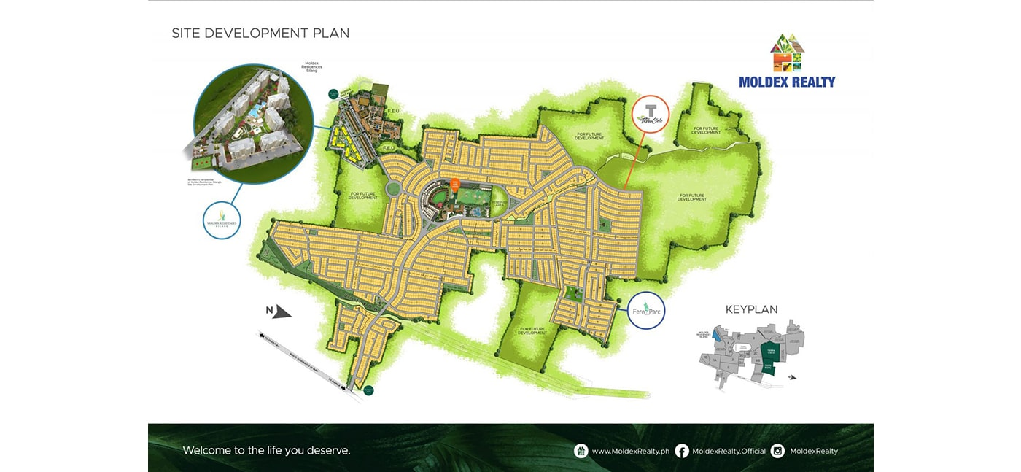
Site plan and selection guide
Move from project interest to the right block and lot
Review together
1. Preferred lot size
2. Inner, corner, main-road, clubhouse, or perimeter location
3. House model fit and setbacks
4. Monthly DP comfort
5. Inventory and official computation
6. Site visit and reservation process
MetroGate Silang Estates
12
Notes:
Official site development plan from Moldex Realty. Site plans are for orientation; rely on the latest official inventory and approved subdivision documents for a transaction.

Slide 13
Next steps
Let’s narrow the best MetroGate Silang Estates option for you.
01
Set your target
Preferred lot size, house model, budget, and move-in timeline.
02
Check live inventory
Confirm the exact block, lot, availability, and current approved price.
03
Visit and decide
Schedule a site tour, review the official computation, and reserve when ready.
Prepared from official Moldex Realty project pages and current internal reference rates. All transaction details remain subject to official verification.
Notes:
Close with the buyer's preferred lot size, target monthly budget, and site-visit availability. Confirm all inventory and pricing through official channels.

